Slide 1
CFA: Basics
Examples

Slide 2
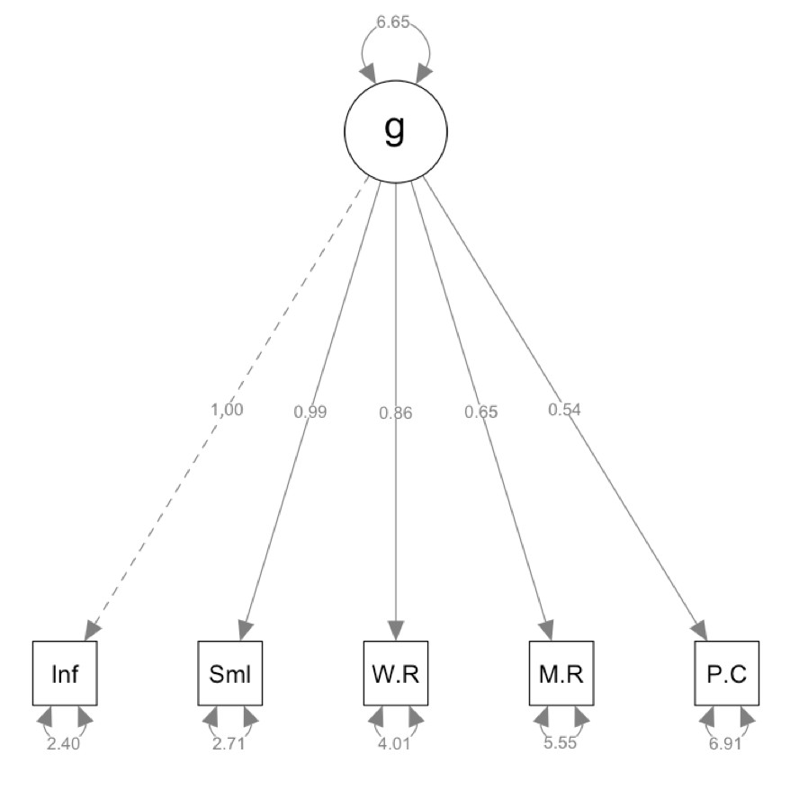
Example 1 – 1 Factor CFA

Slide 3
Example 1 – Import the Data
Use lav_matrix_lower2full
Deal with correlation is already standardized problem?
New function:
cor2cov(correlations, SDs)
Converts correlation tables to covariance tables
You need a correlation matrix AND a vector of SDs
Data is in the chapter 3 R file or in your book around page 39.

Slide 4
Example 1 – Name Everything
Use the colnames() = rownames() function to name the matrix.
Use names(sd vector) to name the standard deviations, so we know which ones to combine correctly.

Slide 5
Example 1 – Convert to Cov Matrix
Use cor2cov(correlation matrix, sd vector)

Slide 6
Example 1 – Define Model
=~ symbol in the model description
Before we did
Y ~ X
Because all the variables were manifest, and we were just predicting Y.
What to do if you have to create a variable?
Now we use =~ to tell lavaan that the Y is a latent variable and to create it.

Slide 7
Example 1 – Run the Model
cfa()
The cfa function does basically the same thing that the sem() function does, but has more options for cfa-ing.
New option in the SEM part (not the summary)
std.lv = Standardize on the Latent Variable.
I recommend leaving this OFF – why? Because the standardized = TRUE in the summary function will show you this output + the unstandardized solution – so why not see both?

Slide 8
Example 1 – Run the Model
std.lv = FALSE
False is the default
Makes the first variable the indicator (i.e. sets it to 1).
TRUE
Sets the latent as the indicator, estimates all loadings and constrains the variance to 1.

Slide 9
Example 1 – Get the Output
summary(model fit, standardized = T, rsquare = T, fit.measures = T)
The standardized part is new.
We will get THREE types of coefficients.
Regular unstandardized
Std.lv = standardized on the latent variable (like a beta).
Std.all = all are standardized, should not go over 1.

Slide 10
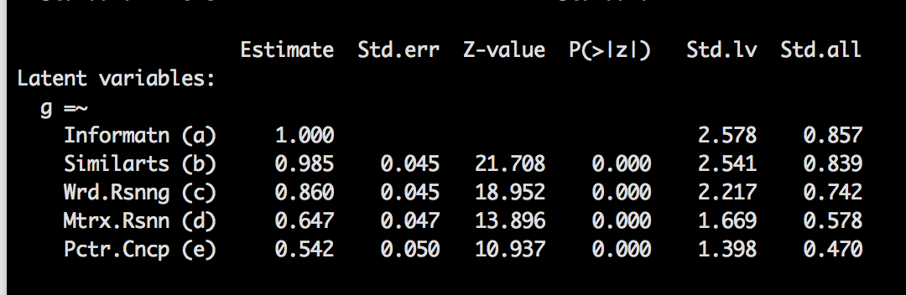
Example 1 – Get the Output
What are the new Standardized Columns?
Std.lv = standardizes the latent variable but leaves manifest in the scale
Std.all = standardizes everything.

Slide 11
Example 1 – Get the Output
Just like we had an extra function for fit – if you wanted to see more of them: fitmeasures(model fit), we also have extra functions for other parts.
parameterestimates(model fit, standardized = T)
This function gives you the estimated values AND the confidence intervals for the unstandardized solution.

Slide 12
Example 1 – Get the Output
fitted() function
Gives you the recreated covariance table
residuals() function
Gives you the difference between actual and reproduced correlation table

Slide 13
Example 1 – Get the Output
fitmeasures(model fit)
How you can get ALL the fit indices!
modificationindices(model fit)
Get the modification indices separately from all the output.

Slide 14
Example 1 – Draw the Picture
Use the semPaths function:
semPaths(model fit,
whatLabels = “par”,
layout = “tree”)
Tree works great for CFAs.
Also try with the standardized solution by changing par to std.

Slide 15
Example 1 – Interpret
Parameter estimates / R Squared
Fit Indices
Residuals
Modification Indices

Slide 16
Things to check out
Heywood cases/logical solution
Are our variances positive + SMCs ok?
Are there any crazy SEs?
Estimates
Did our questions load?
Model fit
Are the fit indices any good?

Slide 17
Parameters
Remember – you want parameters that make sense
You can check out the standardized parameters to determine if questions are still loading like they would in an EFA.
Z = parameter / SE
Sometimes called a critical ratio.

Slide 18
Parameters
Standard errors are tricky
They are based on the scale of the variable
You do not want them to be zero
Estimating no variance is bad … some variance is always good!
You do not want them to be large
That means you are not estimating very well

Slide 19
Model Fit
See previous notes but here’s a quick reminder:
X² nonsignificant (ha!)
RMSEA, SRMR = small numbers
CFI/TLI = large numbers

Slide 20
Model Fit
We talked about modification indices in the last section.
In this section – think about what they mean before adding paths.
Usually CFA is meant to test that specific question/latent combination, so it may not help to add the paths or correlate errors on two different latents.

Slide 21
Model Fit
Overfitted model – when you add parameters that help model fit, but do not help with theory (and probably won’t replicate)

Slide 22
Compare the models!
Use the anova() function for nested models.
Look at differences in CFI
Is the change greater than .01?
Look at the AIC/ECVI
Which one is lower?

Slide 23
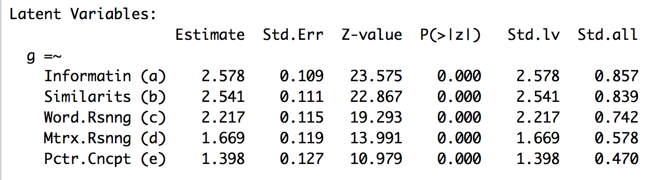
Example 2
Switching to estimating all variables, constraining the variance instead of an indicator.
Use std.lv=TRUE
The main thing to notice here is that the estimate and Std.lv columns are the same in this output.

Slide 24
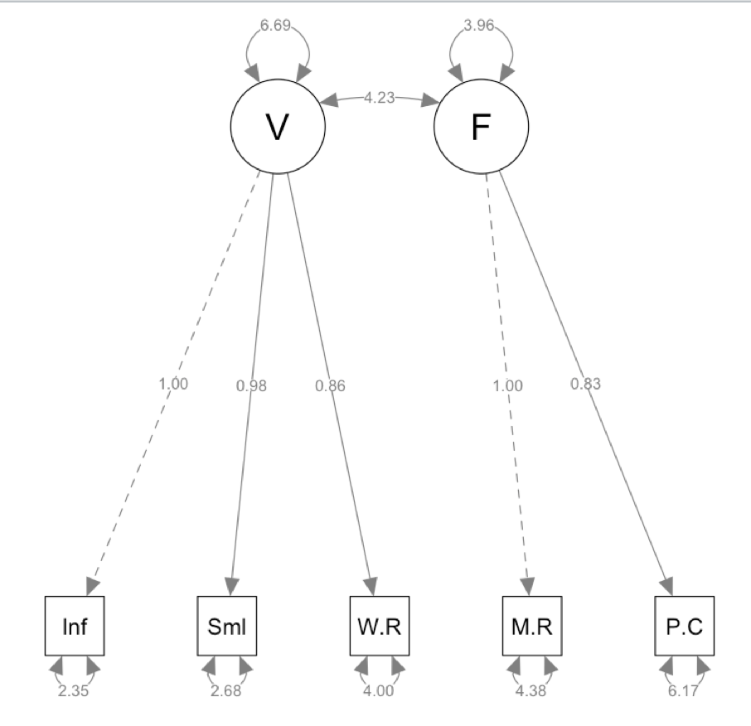
Example 3
Let’s specify a two-factor model!
Page 49 in your book
Verbal and fluid IQ
Estimate with the same dataset.

Slide 25
Example 3 – Define Model
Remember, that you don’t have to use the labels for each parameter.
However, here’s some explanation of the ~~
~ is Y ~ X … y is predicted by X, but all need to be defined first.
=~ defines a latent with manifest variables
~~ defines a covariance

Slide 26
Example 3 – Work through the rest
Run the model.
Get a summary of the model.
Look at other parts of the summary and interpret:
Fit indices
Parameter estimates
R square values
Residuals
Make a picture.

Slide 27
Example 4
A fully latent model!
Preview of a coming lecture.
~ is Y ~ X … y is predicted by X, but all need to be defined first.
=~ defines a latent with manifest variables
~~ defines a covariance
So, now we can do Latent ~ Latent if they are defined first (so the order of the lines matters).

Slide 28
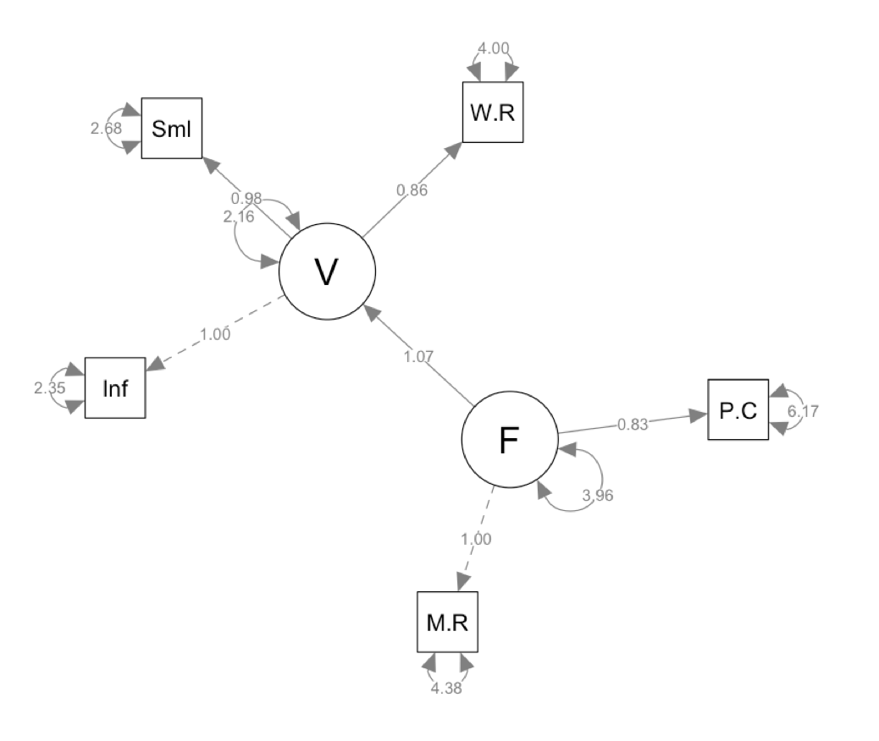
Example 4 - Define Model

Slide 29
Example 4 – Work through the rest
Run the model.
Get a summary of the model.
Look at other parts of the summary and interpret:
Fit indices
Parameter estimates
R square values
Residuals
Make a picture.

Slide 30
Examples Together
 | Model 1 | Model 2 | Model 3 | Model 4
RMSEA | .089 | .089 | 0.063 | 0.063
SRMR | .034 | .034 | 0.019 | 0.019
CFI | .980 | .980 | 0.992 | 0.992
TLI | 0.959 | 0.959 | 0.980 | 0.980
ECVI | 0.085 | 0.085 | 0.063 | 0.063
AIC | 12777.357 | 12777.357 | 12765.269 | 12765.269
X2 (df) | (5) 26.775 | (5) 26.775 | (4) 12.687 | (4) 12.687

